Slide 1
APAC Lead Management and Inside Sales programs
Paula Rizzini
HS Marketing APAC
Jan 2023

Slide 2
Lead Management process

Slide 3
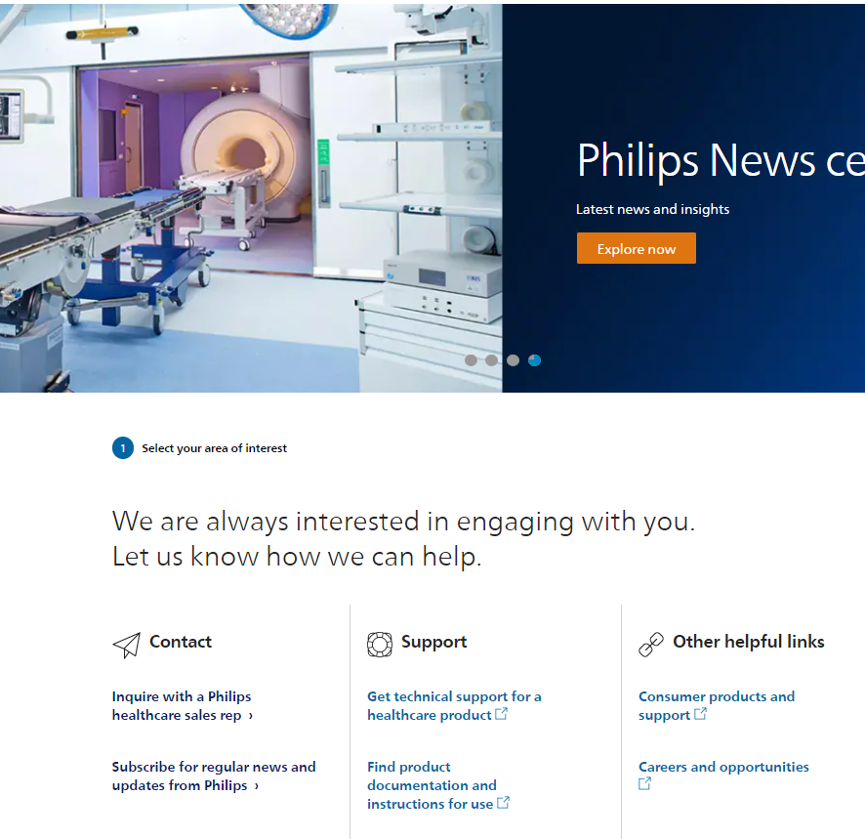
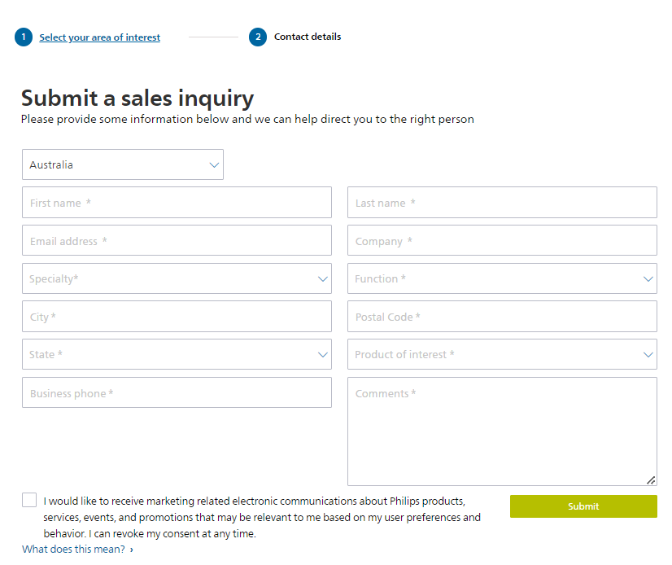
Lead flow
Nurture Required
Converted (Contact)
TQL
Teleprospecting Qualified
Lead
Opportunity
Closed Won
Digital
MQL
Marketing
Qualified
Lead
WIP
Working In Progress
Closed +
Reason for closure
Closed +
Reason for closure
Closed Lost
Email
SFDC
Eloqua
Events
Tele Agent
Account Manager
MQL: A unique individual that has been generated through an Inquiry and met the scoring threshold for a specific Product Of Interest at a specific moment in time to be qualified by marketing. A MQL is ready to be assigned to the Lead Manager for acceptance and qualification. (MQL Marketing Qualified Lead)
Work-in-Progress (WIP): A unique individual that has been visually validated by the Lead Manager and ready to be further qualified by the Lead Manager. In plain words: the Lead is being qualified by the Lead Manager
TQL: A unique individual that has been qualified by the Lead Manager and ready to be assigned to the Account Manager for acceptance and qualification. (TQL Tele-prospecting Qualified Lead)
Nurture Required: Lead is closed because the customer is not yet in the buying cycle yet. A campaign (e-mail, call etc) is required and lead scoring will determine when the Lead will be MQL again.
Converted: Lead is closed by successfully converting into an Opportunity, Contact and/ or Account
Closed: Lead is closed because there is no further action required or possible by the Lead Manager or Account Manager. Reasons for closure (e.g. distributed to partner) are captured in another field

Slide 4
APAC Lead Management process
Indirect sales
Philips
Channel partner
Direct sales
Philips
Day 1-7
Day 7-30
Next months
Closed
Distributed
Closed Won
TA closes lead in SFDC
TA Distributes a lead to AM
Opportunity (Contact or Opportunity)
AM/CP update SFDC
No
Yes
Yes
Prospect/Customer
TA receives MQL in SFDC
Enough info? Real intent?
AM contacts customer to pursue opportunity
Lead meets qualification criteria?
Yes
Does AM get the sale?
AM receives lead
AM updates SFDC
End
No
No
TA enriches lead – call, email
AM/CP update SFDC
AM updates SFDC
TA updates SFDC with info
Closed
Closed Lost
LS: 0
Obj: N/A
LS: 1 MQL
Obj: Validate (Real/ Fake; Intent is right)
LS: 2 – WIP
Obj: Validate (Real/ Fake; Intent is right)
LS: 3 – TQL
Obj: Contact customer to pursue opportunity.
LS: 4 – Opportunity
Obj: create sales opportunity
LS: 5 – OIT
Obj: get the sale
TA: Tele Agent
AM: Account Manager

Slide 5







Best practices sharing – ANZ and PH How did marketing leads go from generating €1.7M OIT in 2020 to €5.8M in 2022 in APAC The objective is to go through this journey with SG and MY to increase OIT
FROM…
…How…
...TO
Structure and Governance
Put in place a standardized process + refined roles & responsibilities to improve:
Lead qualification & enrichment
Lead assignment
Track lead outcome
Track performance vs KPIs
Contact customers within 24h
Lead qualification & enrichment
Lead assignment –7 days
Track lead outcome
Track performance vs KPIs
Monthly report to markets on performance
Lead Management report added to the leadership DM call for revision and action
Increase in conversion rate and OIT due to a higher lead velocity and better customer experience
Sales team sees the value of marketing leads
and follow the below timlines:
Contact customer within 2 days
Update SFDC with Opportunity status or close lead within 23 days
To assign leads to channel partners as opportunities
Sales Excellence integrated the lead management process into their sales and channel partner training
Sales excellence endorses the program and
addresses gaps with the leadership
No dedicated resources, scattered in the org and not centrally managed nor best practices shared
Dedicated, named Lead Managers positioned according to a blue print
Top-down support of capability
Process and Systems
Program leader
Ambiguous process guidelines and inconsistent usage
Clear process design and KPIs
Tele agent
Performance tracking
Lack of traceability
Poor quality reporting
Dashboard defined and review cadence in place
Data focused decision making
People and Culture
Customer experience elevated due to swift follow up and E2E information sharing
Lead Manager well positioned within Marketing & Sales
Customer touchpoints not followed up well
Marketing & Sales working isolated
Sales
Capability and Learning
Sales Excellence and Marketing working with different processes and objectives
Sales Excellence and marketing collaborating with a combined objective
Lead Management training being provided to sales and channel partners by sales excellence
Sales Excellence

Slide 6
Lead Management and
Inside Sales team capabilities

Slide 7
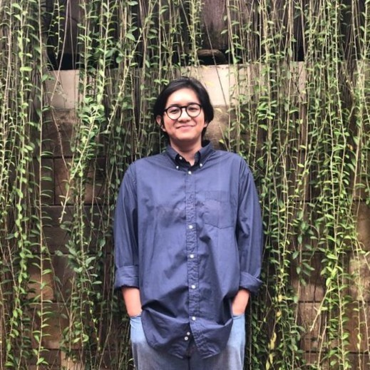

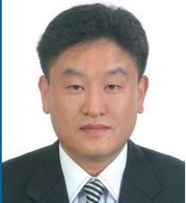
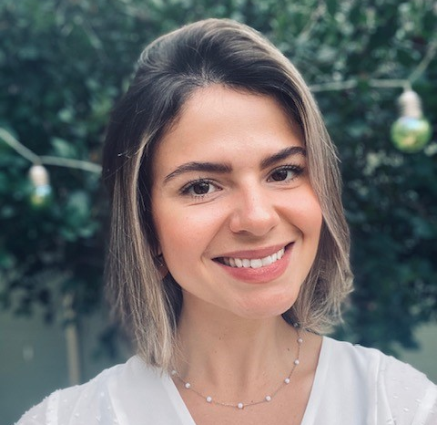
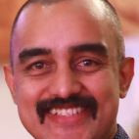
Lead Management and Inside Sales team supporting 9 countries* in demand generation and customer nurturing programs
LM
Qualify and enhance leads
Assign leads based on the lead matrix
Make sure SFDC is updated according to LM process rules;​
Respond to every lead within 24h; ​
IS
Prospect customers to generate opportunities
Call/email avg. 40 customers per day (capacity)
Assign oppty based on lead matrix
Close Lumify deals ($$)
Tele agents
Akbar Rumandung
Bachelor’s degree in International Relations
Language: Bahasa and English
Market coverage: All apart from TH and VNM
Time at Philips: 6 months
Working days: Full-time
Polly Ponsaen
Certificate IV in Frontline Management – Cambridge International College Australia
Language: Thai and English
Market coverage: ANZ, TH
Time at Philips: 2 years
Working days: Full-time
Steven, Kang(강 용석)
Bachelor of Science (In Korea) - Master of Business and Administration (In Korea)
Language: Korean (Native)
Market coverage: KR
Time at Philips: 2 years
Working days: Tue and Thu (half day)
LM
Enable tele agents by providing regular training and support
Keep materials updated and relevant
Manage internal stakeholders
Address any gaps during the process
Report on performance
IS
Prospect new programs and create content/scope/script with the businesses
Manage the overall program and report on results to the business
Enablers
Paula Rizzini
Digital Marketing Manager APAC
Project lead
Ravi Venkatachalapathy
Account Manager ASEAN and APAC at Verticurl
Project coordinator
*It includes small islands

Slide 8





APAC Demand Generation and nurture program options
Program scopes can be adapted based on the business needs
Data management
Events
Registration/follow up
Lead Management
Demand generation Acquisition/upgrade/upsell
Services
Retention
Account
profiling
Event
RSVP
Lead qualification
Prospect with closed leads/opportunities
Preventive maintenance drive / contract renewal (T2/T3)
Data segmentation
Post-event follow up
Lead
nurture
Generate opportunity for EOL/EOS - IB
Customers
Generate opportunities for TechMaximizer and other offerings
Data list
building
Lead
assignment
Data
upload
Lead processing – MQL - OIT
Campaign follow-up
Lead enhancement
Lead assignment
Lead reporting
Inbound call
Lead matrix update
Customer re-engagement
Cold/Warm calling
Opportunity generation
Warm calling
Contract extension
Contract renewal
Data cleansing
Data entry
Data mapping
Data enhancement
Event registration
Post webinar demand generation
For further information about these programs contact Paula Rizzini

